Slide 1
Stability, Fairness and the Pursuit of Happiness*
Gerdus Benade
*In recommender systems

Slide 2

Joint with
Nachiketa Sahoo
Notes:
Setting to keep in mind: food banks

Slide 3
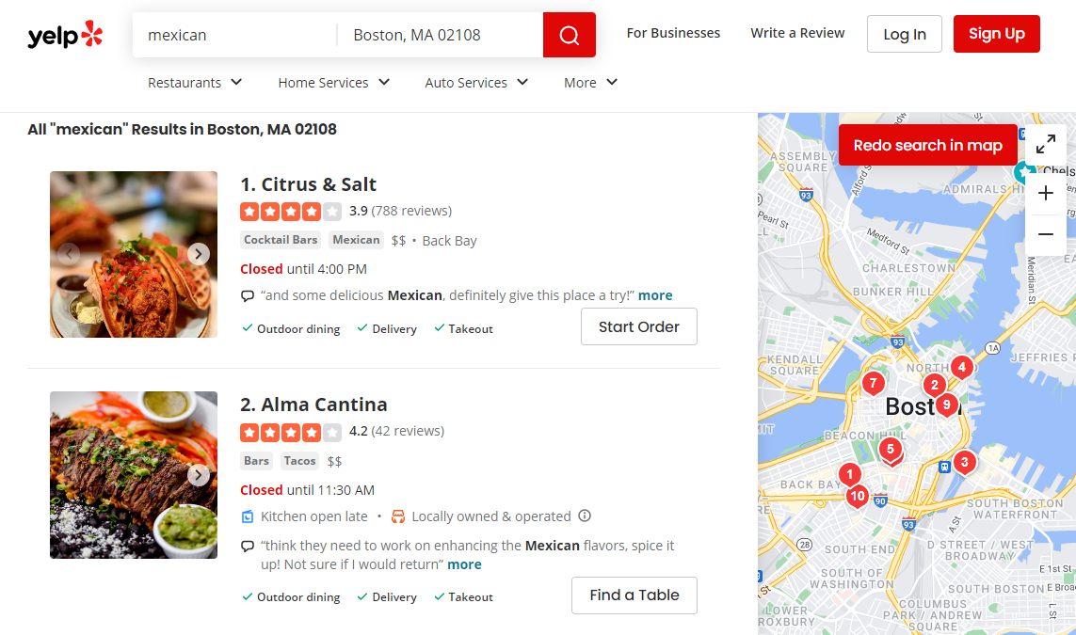


Recommender systems
Recommend a subset of items to users, given varying degrees of information about user and item attributes, buyer chooses one
Notes:
Not purely by avg rating
Either some user-specific customization or some exploration/exploitation tradeoffs happening

Slide 4
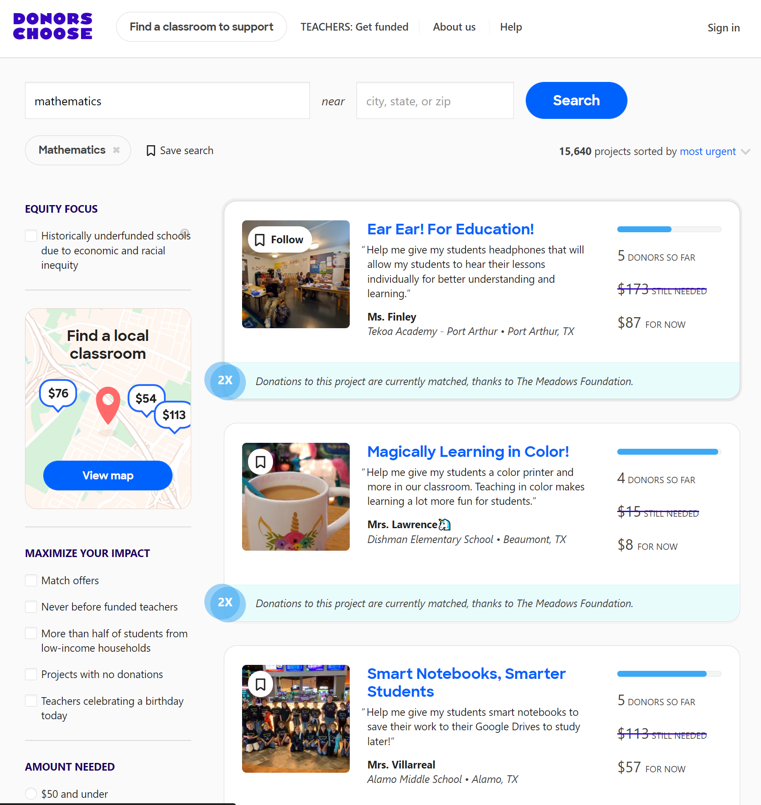

Recommender systems
Recommend a subset of items to users, given varying degrees of information about user and item attributes, buyer chooses one

Slide 5
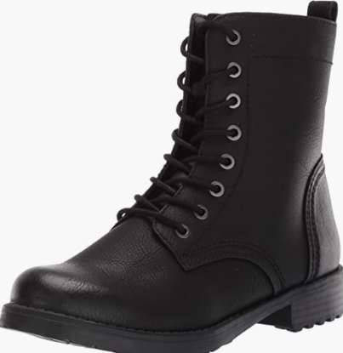
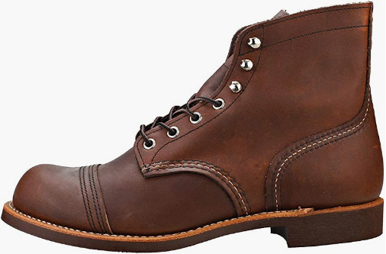
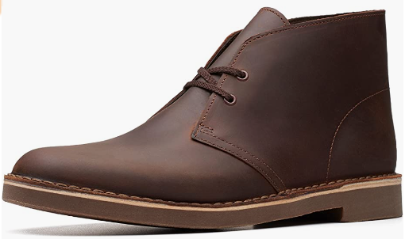



Recommender systems
Recommend a subset of items to users, given varying degrees of information about user and item attributes, buyer chooses one
Most relevant items
2.5 | 2 | 1 | 0.5
2 | 2.5 | 0.5 | 1

Slide 6
Recommender systems
Recommend a subset of items to users, given varying degrees of information about user and item attributes, buyer chooses one
Keep seller 3 happy
2.5 | 2 | 1 | 0.5
2 | 2.5 | 0.5 | 1

Slide 7
Recommender systems
Recommend a subset of items to users, given varying degrees of information about user and item attributes, buyer chooses one
Recommend every item at most once
2.5 | 2 | 1 | 0.5
2 | 2.5 | 0.5 | 1

Slide 8
Recommender systems
Recommend a subset of items to users, given varying degrees of information about user and item attributes, buyer chooses one
May have constraints on the number of exposures
Capacities, preventing stockouts
Exposures are a limited resource
Multiple stakeholders
Platform, Users/Buyers, Items/Sellers
Notes:
Constraints – not relevant for digital good, movies/music
Multiple objective/explore exploit etc
Maximizing buyer satisfaction may be different from maximizing platform profit, from seller satisfaction etc.
Ignore platform, aspects of fairness for buyers/sellers

Slide 9
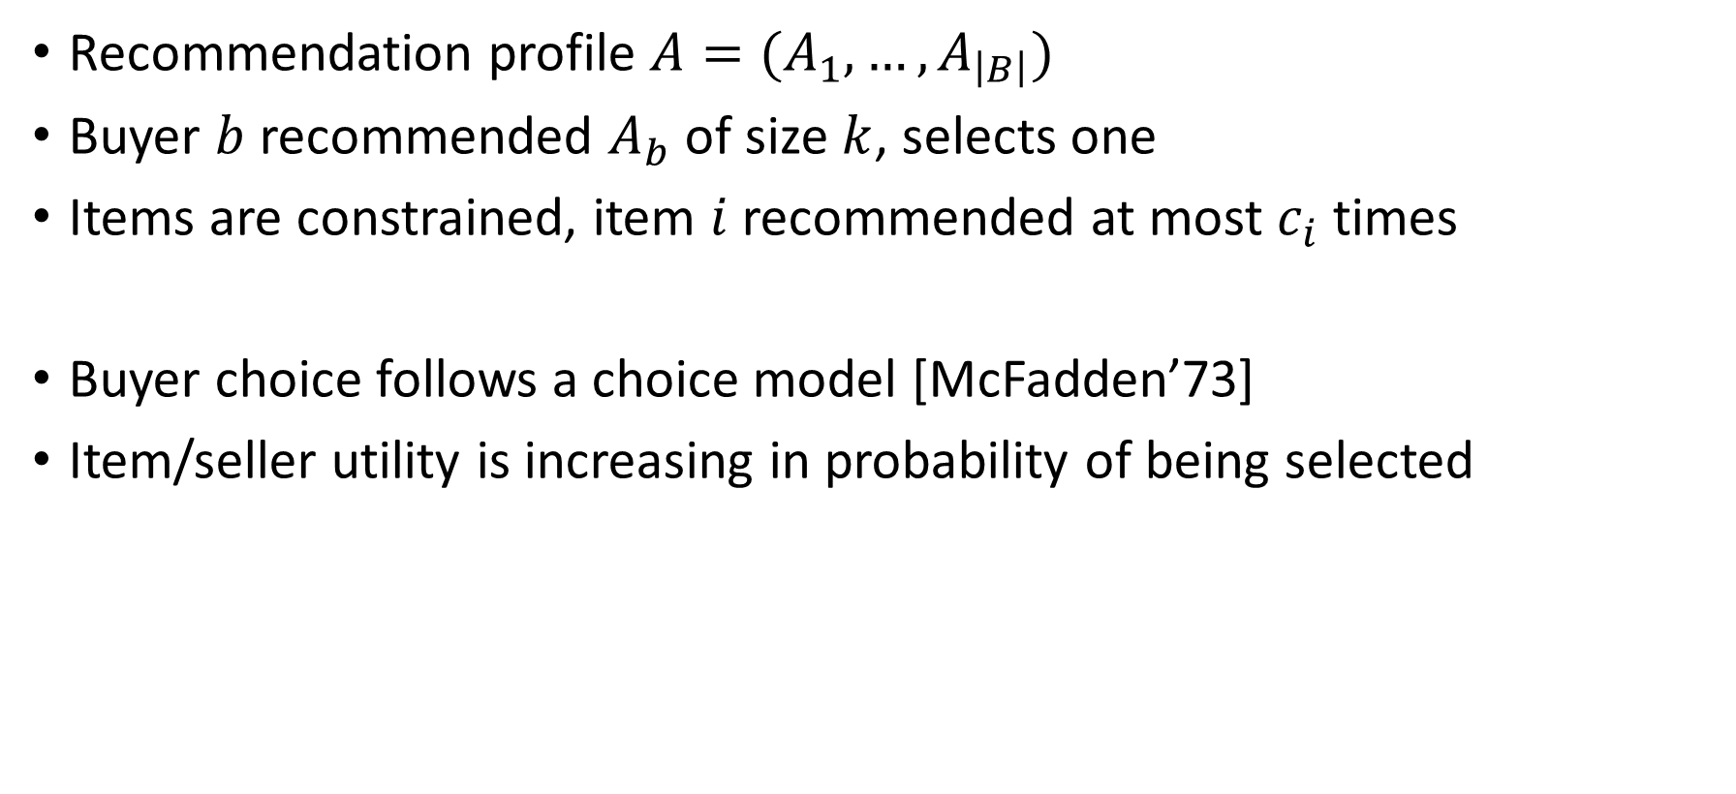
Model for batch recommendations
Recommendation profile $A=(A_{1},…, A_{\left|B\right|})$
Buyer $b$ recommended $A_{b}$ of size $k$, selects one
Items are constrained, item $i$recommended at most $c_{i}$ times
Buyer choice follows a choice model [McFadden’73]
Item/seller utility is increasing in probability of being selected

Slide 10
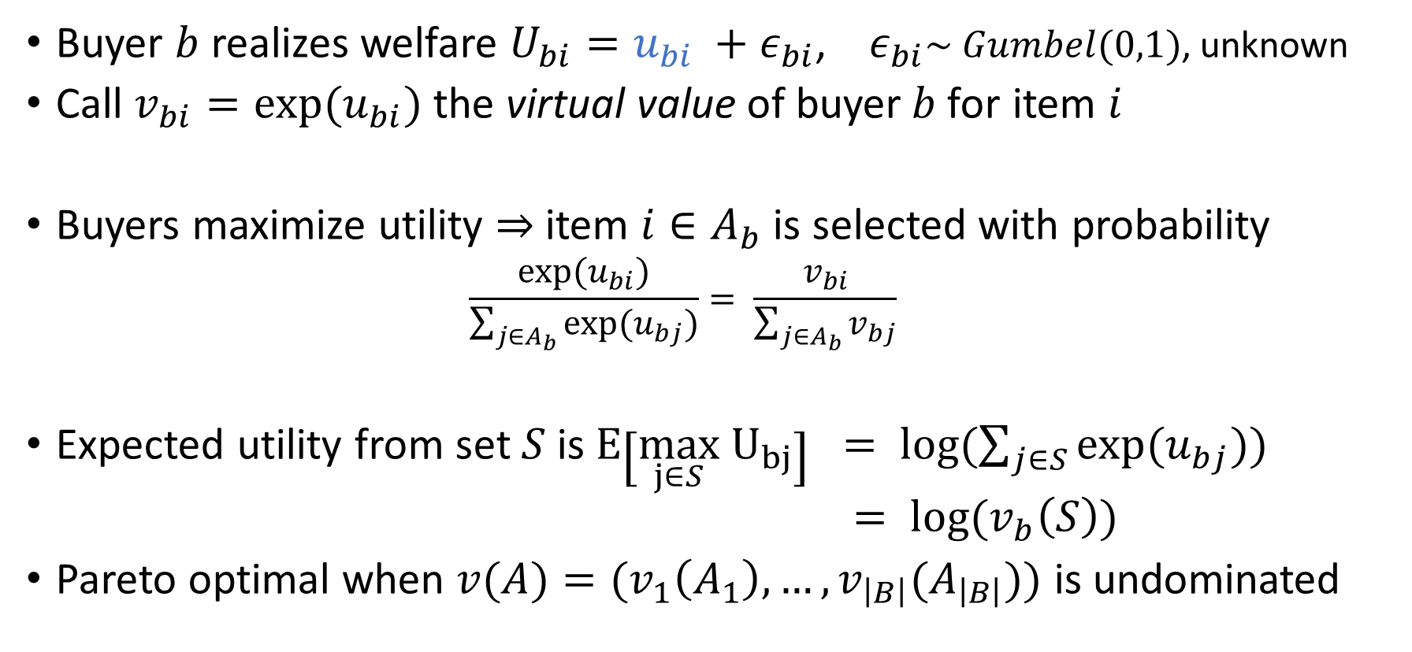
Buyer behavior follows a choice model
Buyer $b$ realizes welfare $U_{bi}=u_{bi} +ε_{bi}$, $ε_{bi}\sim Gumbel(0,1)$, unknown
Call $v_{bi}=exp⁡(u_{bi})$ the virtual value of buyer$b$for item $i$
Buyers maximize utility $⇒$item $i∈A_{b}$ is selected with probability
$$\frac{\exp{{(u}_{bi})}}{\sum_{j∈A_{b}}{\exp{(u_{bj})}}}= \frac{v_{bi}}{\sum_{j∈A_{b}}{v_{bj}}}$$
Expected utility from set $S$is$E\left[\max_{j∈S} U_{bj}\right] = \log{(\sum_{j∈S}{\exp{(u_{bj})})}}$
$= \log{(v_{b}\left(S\right))}$
Pareto optimal when $v(A)={(v}_{1}\left(A_{1}\right), …, v_{\left|B\right|}(A_{\left|B\right|}))$ is undominated
Notes:
u_bi – known to us, epsilon unknown to us, realized by the buyer when considering the item
PO in terms of virtual values also PO in terms of wefare
Gumbel mean 0 beta 1 = extreme value type 1
Models distribution of maxima of multiple samples from a distribution.
F(x) = exp(-exp(-s))

Slide 11
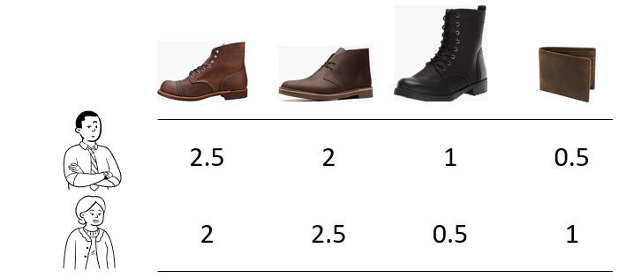
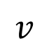
Back to example
Preference orders
: , , ,
: ( , ), ( , ), ( , ), ( , ), … , ( , )
$$v$$
$\frac{2.5}{3}=\frac{5}{6}$ $\frac{2}{2.5}=0.8$ $\frac{2.5}{3.5}=0.71$ $\frac{2}{3}=0.66$ $\frac{2}{4.5}=0.44$
Notes:
Deferred acceptance schemes typically conditionally accept someone until someone better comes along

Slide 12
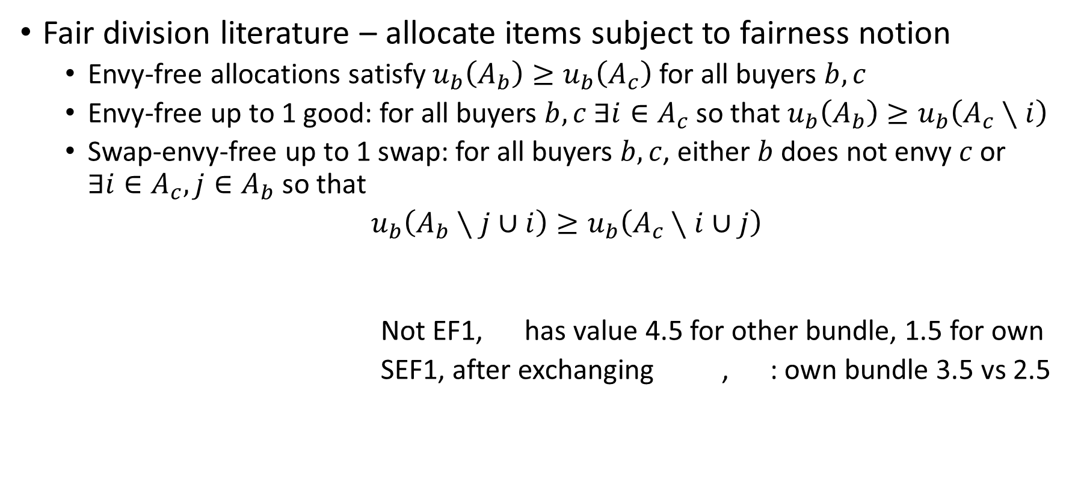
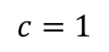
Constrained recommendations as fair assignments
Fair division literature – allocate items subject to fairness notion
Envy-free allocations satisfy $u_{b}\left(A_{b}\right)≥u_{b}\left(A_{c}\right)$ for all buyers $b,c$
Envy-free up to 1 good: for all buyers $b,c$ $∃i∈A_{c}$ so that $u_{b}\left(A_{b}\right)≥u_{b}\left(A_{c}∖i\right)$
Swap-envy-free up to 1 swap: for all buyers $b,c$, either $b$ does not envy $c$or $∃i∈A_{c}, j∈A_{b}$ so that
$u_{b}\left(A_{b}∖j∪i\right)≥u_{b}\left(A_{c}∖i∪j\right)$
Not EF1, has value 4.5 for other bundle, 1.5 for own
SEF1, after exchanging , : own bundle 3.5 vs 2.5
$$c=1$$
Notes:
Igarashi et al – 22 define swap envy identically
Why swap envy – k recommendations are only feasible on bundles of size k, so comparing feasible allocations

Slide 13
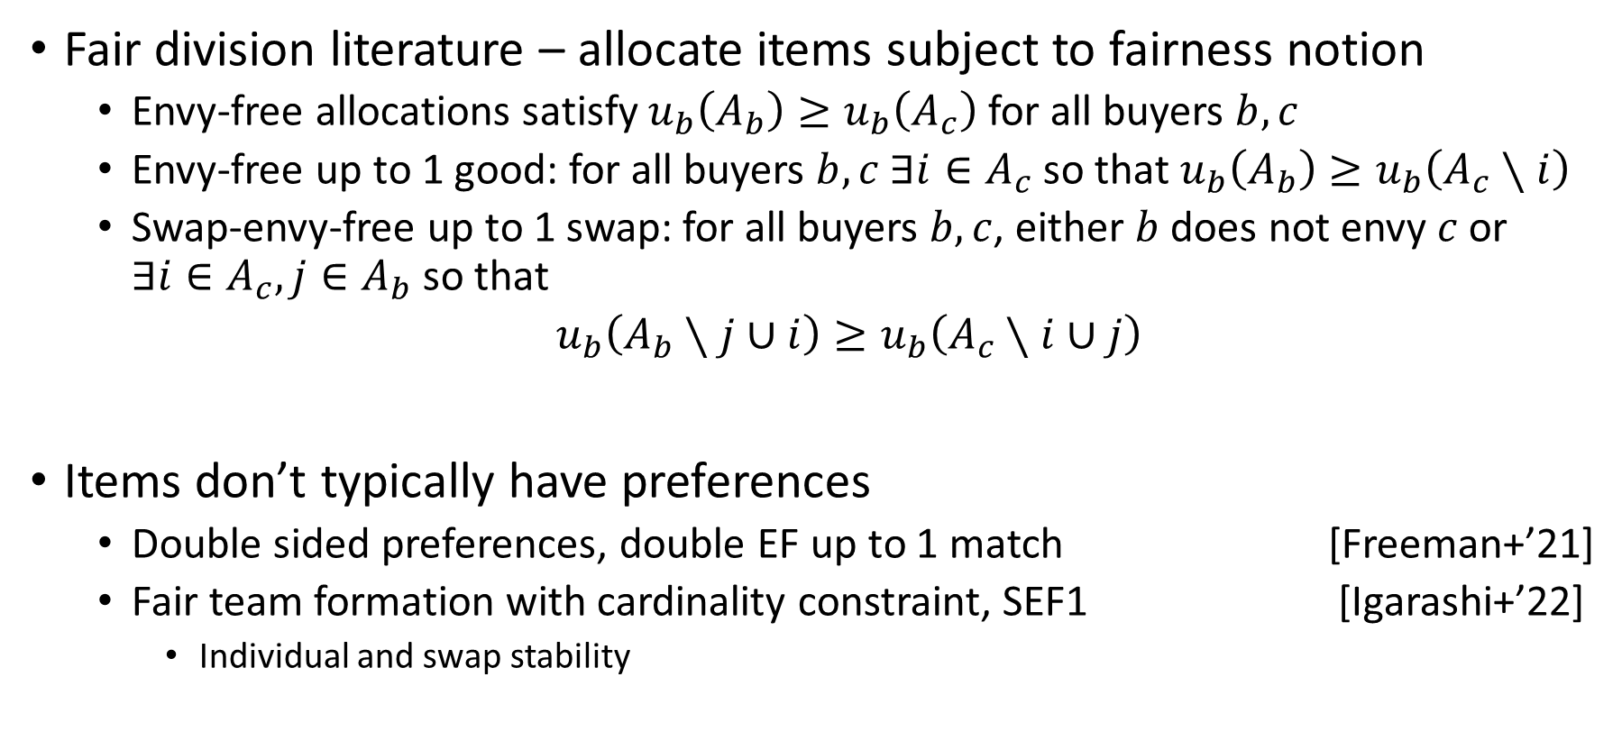
Constrained recommendations as fair assignments
Fair division literature – allocate items subject to fairness notion
Envy-free allocations satisfy $u_{b}\left(A_{b}\right)≥u_{b}\left(A_{c}\right)$ for all buyers $b,c$
Envy-free up to 1 good: for all buyers $b,c$ $∃i∈A_{c}$ so that $u_{b}\left(A_{b}\right)≥u_{b}\left(A_{c}∖i\right)$
Swap-envy-free up to 1 swap: for all buyers $b,c$, either $b$ does not envy $c$or $∃i∈A_{c}, j∈A_{b}$ so that
$u_{b}\left(A_{b}∖j∪i\right)≥u_{b}\left(A_{c}∖i∪j\right)$
Items don’t typically have preferences
Double sided preferences, double EF up to 1 match [Freeman+’21]
Fair team formation with cardinality constraint, SEF1 [Igarashi+’22]
Individual and swap stability
Notes:
Freeman, Misha, Shah – for identical preferences a version of round robin is double EF1
Igarashi – Sef1
Swap stability – no swap makes at least 1 party better off, others no worse
Individual stability – no swap makes player better off, neither team worse off

Slide 14
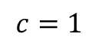
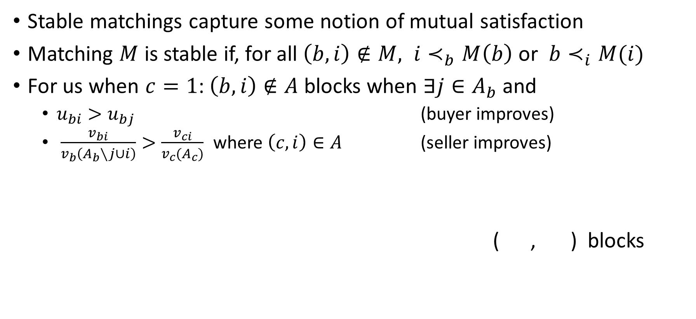
Constrained recommendations as matchings
Stable matchings capture some notion of mutual satisfaction
Matching $M$ is stable if, for all $\left(b,i\right)∉M, i≺_{b}M\left(b\right)$ or $b≺_{i}M(i)$
For us when $c=1$: $\left(b,i\right)∉A$ blocks when $∃j∈A_{b}$ and
$u_{bi}>u_{bj}$ (buyer improves)
$\frac{v_{bi}}{v_{b}\left(A_{b}∖j∪i\right)}>\frac{v_{ci}}{v_{c}(A_{c})}$ where $\left(c,i\right)∈A$ (seller improves)
( , ) blocks
$$c=1$$
Notes:
General: require that it is possible to feasibliy complete the recommendation – equiv assume a number of dummy items of lowest value available
Sometimes seen it called feasibly stable

Slide 15
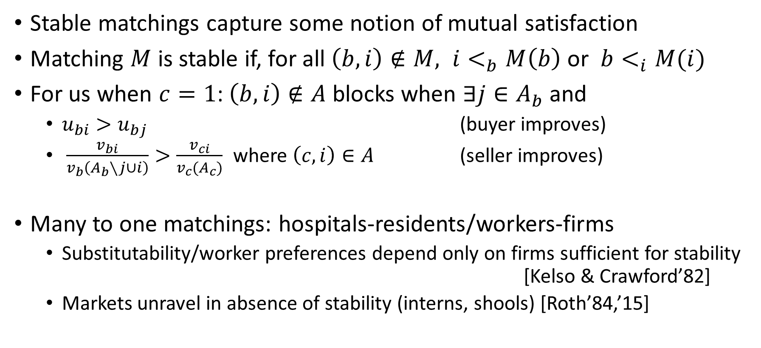
Constrained recommendations as matchings
Stable matchings capture some notion of mutual satisfaction
Matching $M$ is stable if, for all $\left(b,i\right)∉M, i<_{b}M\left(b\right)$ or $b<_{i}M(i)$
For us when $c=1$: $\left(b,i\right)∉A$ blocks when $∃j∈A_{b}$ and
$u_{bi}>u_{bj}$ (buyer improves)
$\frac{v_{bi}}{v_{b}\left(A_{b}∖j∪i\right)}>\frac{v_{ci}}{v_{c}(A_{c})}$ where $\left(c,i\right)∈A$ (seller improves)
Many to one matchings: hospitals-residents/workers-firms
Substitutability/worker preferences depend only on firms sufficient for stability [Kelso & Crawford’82]
Markets unravel in absence of stability (interns, shools) [Roth’84,’15]
Notes:
Substitutability – if x in choice set (contracts) of options A, then x should still be in the choice set after removing something else from A
Different versions of substitutes tudy in various settings - all around this same idea, if you accept, then you accept with fewe options/reject -> reject with more options
- OURS – very much depends on other items in the choice set
Is stability really required, esp in absence of complete info about preferences. School students. Hospitals interns

Slide 16
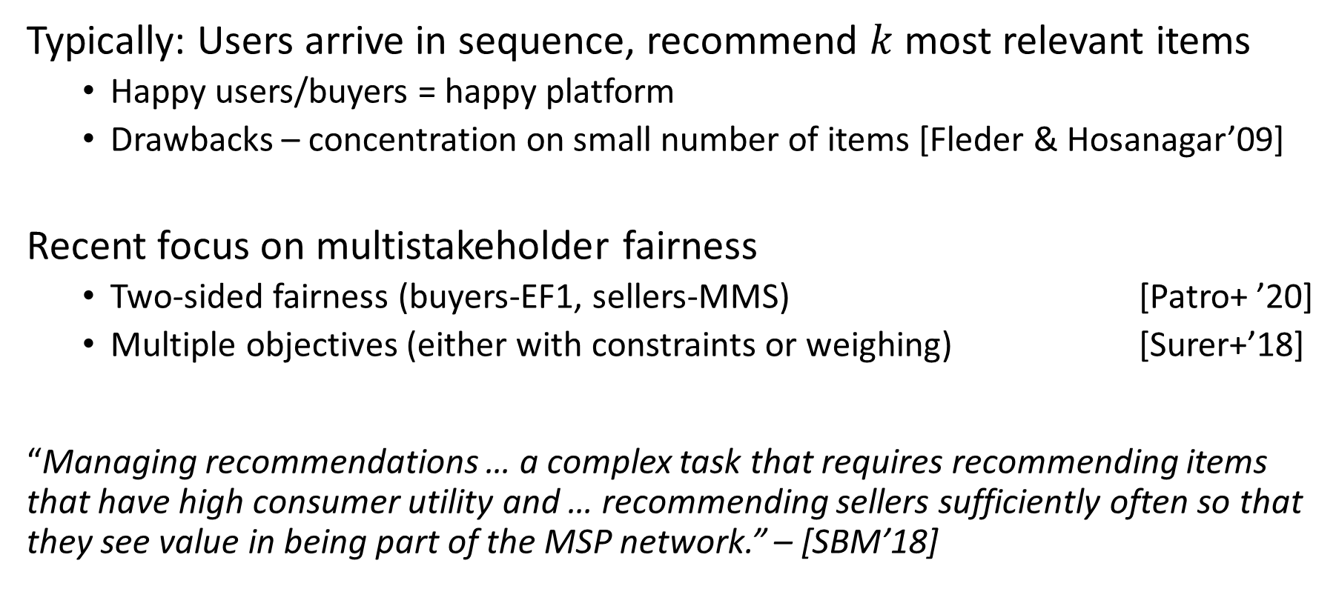
Recommender systems literature
Typically: Users arrive in sequence, recommend $k$most relevant items
Happy users/buyers = happy platform
Drawbacks – concentration on small number of items [Fleder & Hosanagar’09]
Recent focus on multistakeholder fairness
Two-sided fairness (buyers-EF1, sellers-MMS) [Patro+ ’20]
Multiple objectives (either with constraints or weighing) [Surer+’18]
“Managing recommendations … a complex task that requires recommending items that have high consumer utility and … recommending sellers sufficiently often so that they see value in being part of the MSP network.” – [SBM’18]
Notes:
SBM – Surer, Burke, Malthouse (Multistakeholder Recommendation with Provider Constraints Özge)
Contribute to this – our version of 2-sided fairness is stability

Slide 17
Can we guarantee stable, fair and efficient recommendations?
Notes:
In batches
Stability – both buyers and sellers
Fairness – EF/SEF1 on buyer side
Efficient – PO on buyer side

Slide 18
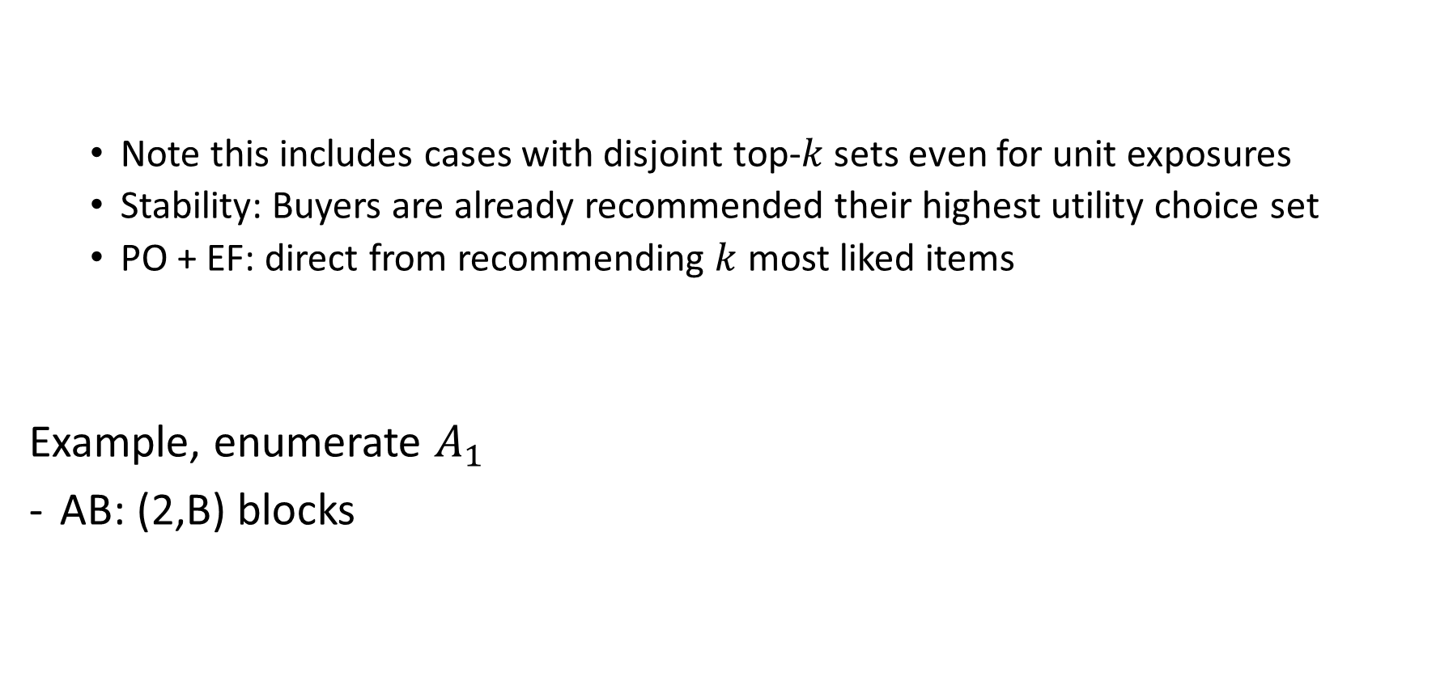
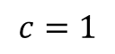
It depends on the exposure constraint
Obs1. When the exposure constraints are not binding, top-$k$ recommendations are stable, EF and PO
Note this includes cases with disjoint top-$k$ sets even for unit exposures
Stability: Buyers are already recommended their highest utility choice set
PO + EF: direct from recommending $k$ most liked items
Example, enumerate $A_{1}$
AB: (2,B) blocks
Obs2. Under unit exposures, stable recommendations need not exist
 | A | B | C | D
1 | 10 | 0 | 7 | 6
2 | 10 | 8 | 4 | 5
$$c=1$$
Notes:
Whenever the capacity constraints are irrelevant – top k is good. Digital/information goods – movies/music etc
To the best of our knowledge hasn’t been observed before. Top-ks are common, turn out they trivially) are stable, which says something about seller satisfaction too.
Example is quite flexible – can construct similar example where factorized. Also for identical order.

Slide 19
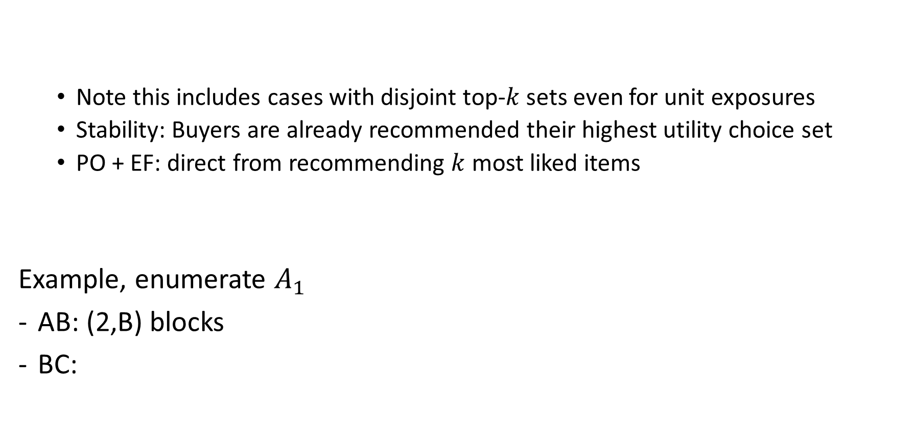
It depends on the exposure constraint
Obs1. When the exposure constraints are not binding, top-$k$ recommendations are stable, EF and PO
Note this includes cases with disjoint top-$k$ sets even for unit exposures
Stability: Buyers are already recommended their highest utility choice set
PO + EF: direct from recommending $k$ most liked items
Example, enumerate $A_{1}$
AB: (2,B) blocks
BC:
Obs2. Under unit exposures, stable recommendations need not exist
 | A | B | C | D
1 | 10 | 0 | 7 | 6
2 | 10 | 8 | 4 | 5
$$c=1$$
Notes:
Also true for BD, 2b still blocks

Slide 20
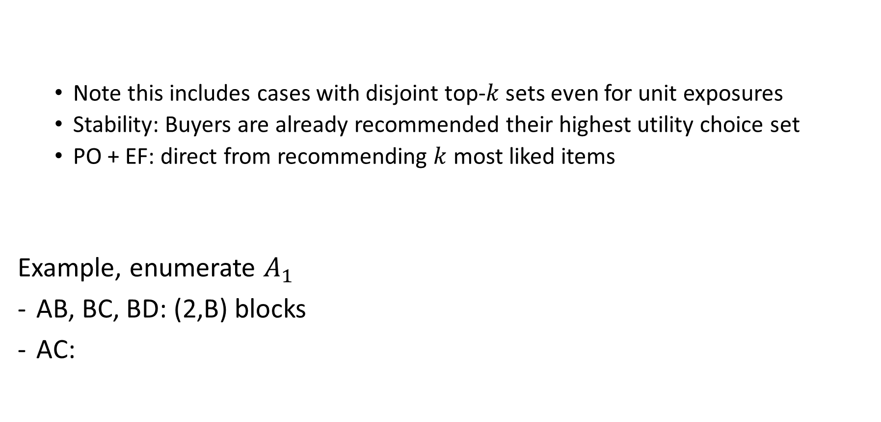
It depends on the exposure constraint
Obs1. When the exposure constraints are not binding, top-$k$ recommendations are stable, EF and PO
Note this includes cases with disjoint top-$k$ sets even for unit exposures
Stability: Buyers are already recommended their highest utility choice set
PO + EF: direct from recommending $k$ most liked items
Example, enumerate $A_{1}$
AB, BC, BD: (2,B) blocks
AC:
Obs2. Under unit exposures, stable recommendations need not exist
 | A | B | C | D
1 | 10 | 0 | 7 | 6
2 | 10 | 8 | 4 | 5
$$c=1$$

Slide 21
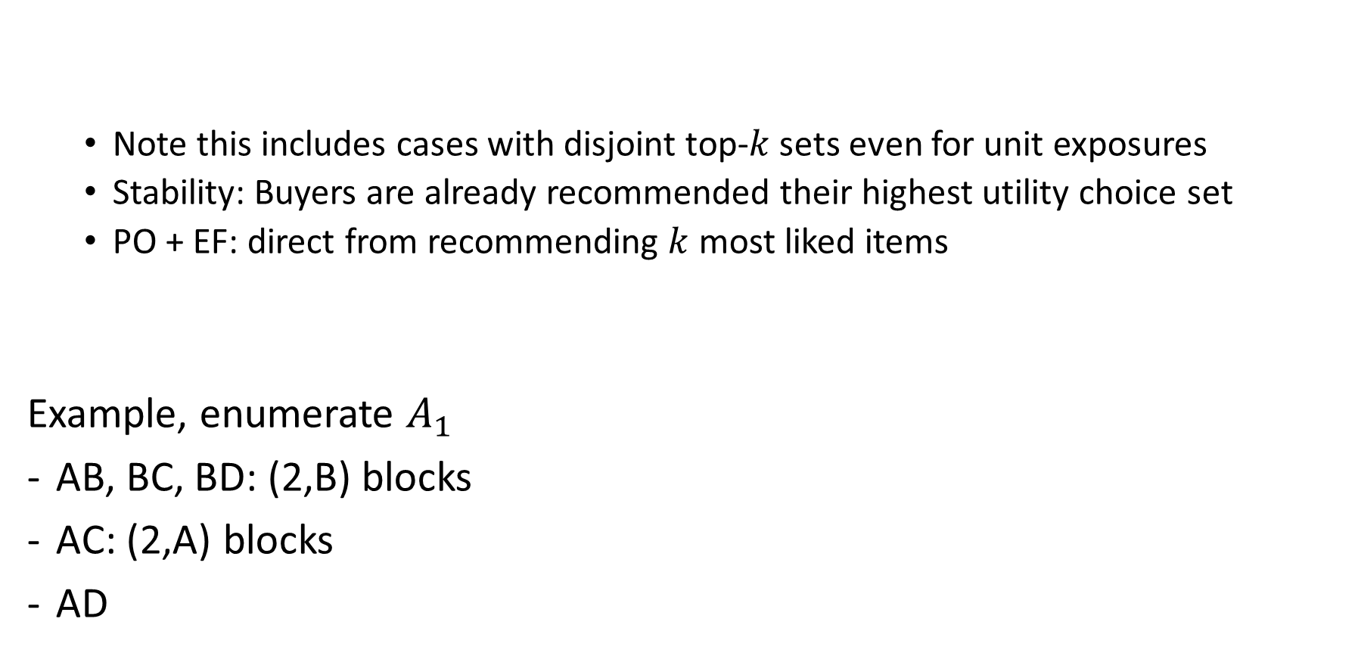
It depends on the exposure constraint
Obs1. When the exposure constraints are not binding, top-$k$ recommendations are stable, EF and PO
Note this includes cases with disjoint top-$k$ sets even for unit exposures
Stability: Buyers are already recommended their highest utility choice set
PO + EF: direct from recommending $k$ most liked items
Example, enumerate $A_{1}$
AB, BC, BD: (2,B) blocks
AC: (2,A) blocks
AD
Obs2. Under unit exposures, stable recommendations need not exist
 | A | B | C | D
1 | 10 | 0 | 7 | 6
2 | 10 | 8 | 4 | 5
$$c=1$$
Notes:
Whenever the capacity constraints are irrelevant – top k is good. Digital/information goods – movies/music etc
To the best of our knowledge hasn’t been observed before. Top-ks are common, turn out they trivially) are stable, which says something about seller satisfaction too.
Example is quite flexible – can construct similar example where factorized. Also for identical order.

Slide 22
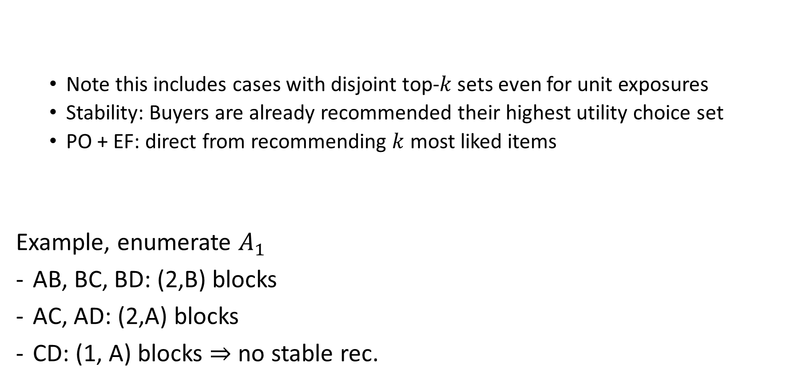
It depends on the exposure constraint
Obs1. When the exposure constraints are not binding, top-$k$ recommendations are stable, EF and PO
Note this includes cases with disjoint top-$k$ sets even for unit exposures
Stability: Buyers are already recommended their highest utility choice set
PO + EF: direct from recommending $k$ most liked items
Example, enumerate $A_{1}$
AB, BC, BD: (2,B) blocks
AC, AD: (2,A) blocks
CD: (1, A) blocks $⇒$ no stable rec.
Obs2. Under unit exposures, stable recommendations need not exist
 | A | B | C | D
1 | 10 | 0 | 7 | 6
2 | 10 | 8 | 4 | 5
$$c=1$$
Notes:
Example is quite flexible – can construct similar example where factorized. Also for identical order.
2 directions – theoretically – can we find any restricted preference domains where it is possible to guarantee stability
Practically – given a specific instance, is stability possible? minimize possible deviation if not

Slide 23
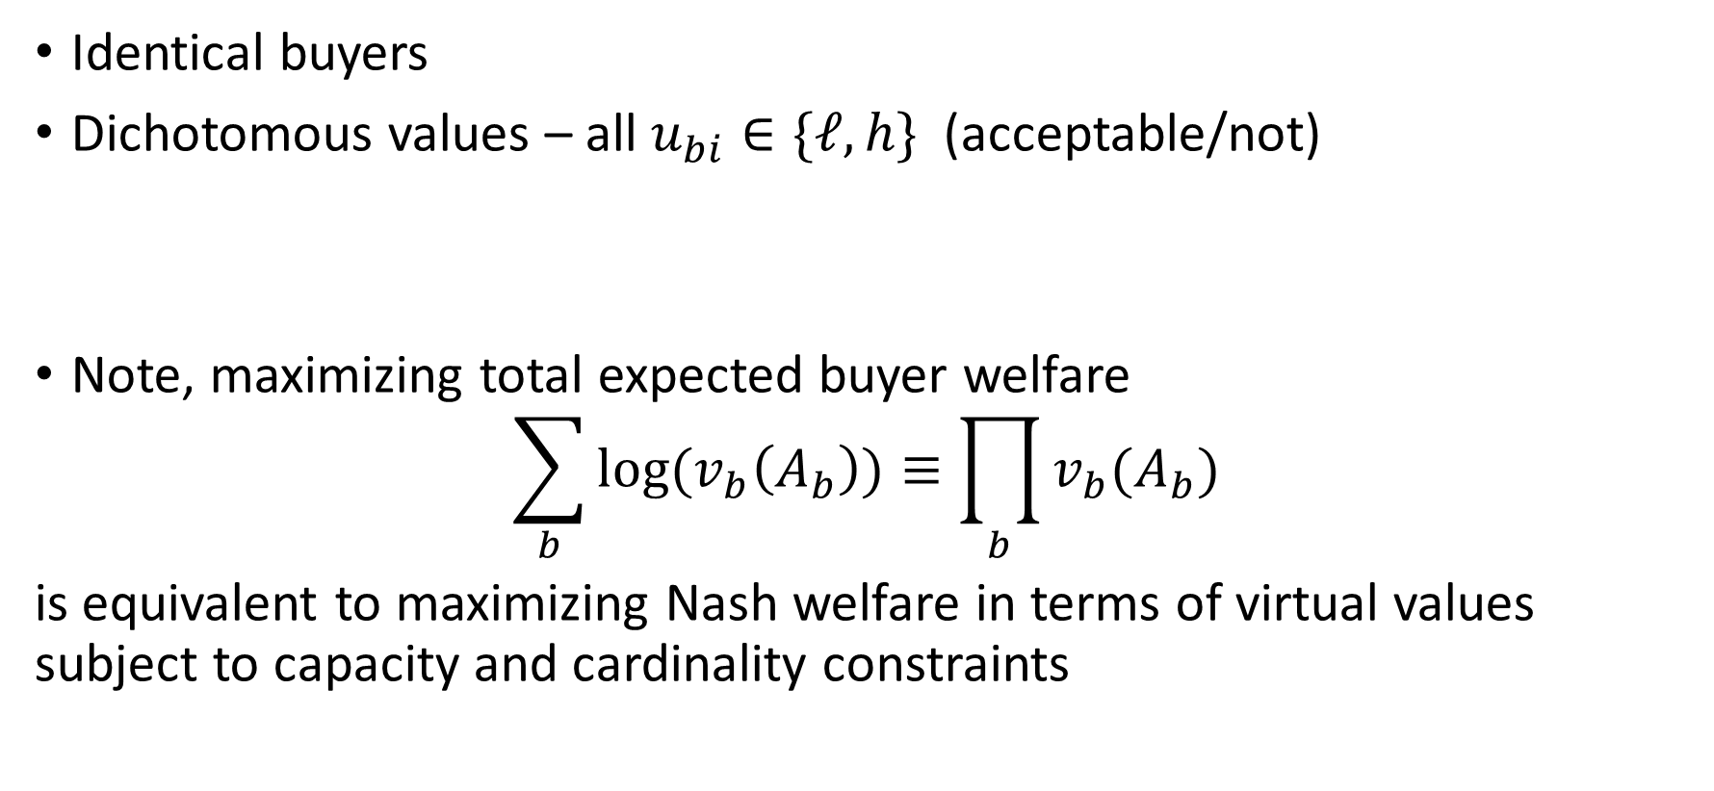
Special cases that allow stability
Identical buyers
Dichotomous values – all $u_{bi}∈\{ℓ,h\}$ (acceptable/not)
Note, maximizing total expected buyer welfare
$$\sum_{b}{\log{(v_{b}\left(A_{b}\right))}}≡\prod_{b}{v_{b}(A_{b})}$$
is equivalent to maximizing Nash welfare in terms of virtual values subject to capacity and cardinality constraints
Thm. In these two settings under unit exposure constraints, maximizing expected buyer welfare is stable, SEF1 and PO
Notes:
MNW is ef1, PO from fair division literature

Slide 24
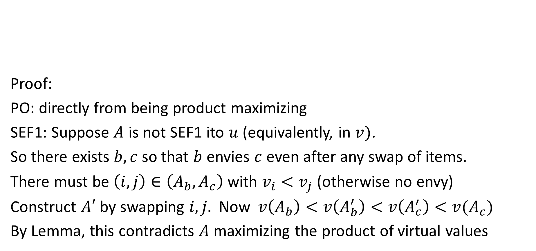
Proof sketch for identical values
Proof:
PO: directly from being product maximizing
SEF1: Suppose $A$ is not SEF1 ito $u$ (equivalently, in $v)$.
So there exists $b,c$ so that $b$ envies $c$ even after any swap of items.
There must be $\left(i,j\right)∈\left(A_{b},A_{c}\right)$ with $v_{i}<v_{j}$ (otherwise no envy)
Construct $A′$ by swapping $i,j.$ Now$v\left(A_{b}\right)<v\left(A_{b}^{′}\right)<v\left(A_{c}^{′}\right)<v(A_{c})$
By Lemma, this contradicts $A$ maximizing the product of virtual values
Thm. For identical buyers under unit exposure constraints, maximizing expected buyer welfare is stable, SEF1 and PO
Lem. For $a+b=C, a⋅b$ increases in $\min\left(a,b\right)$

Slide 25
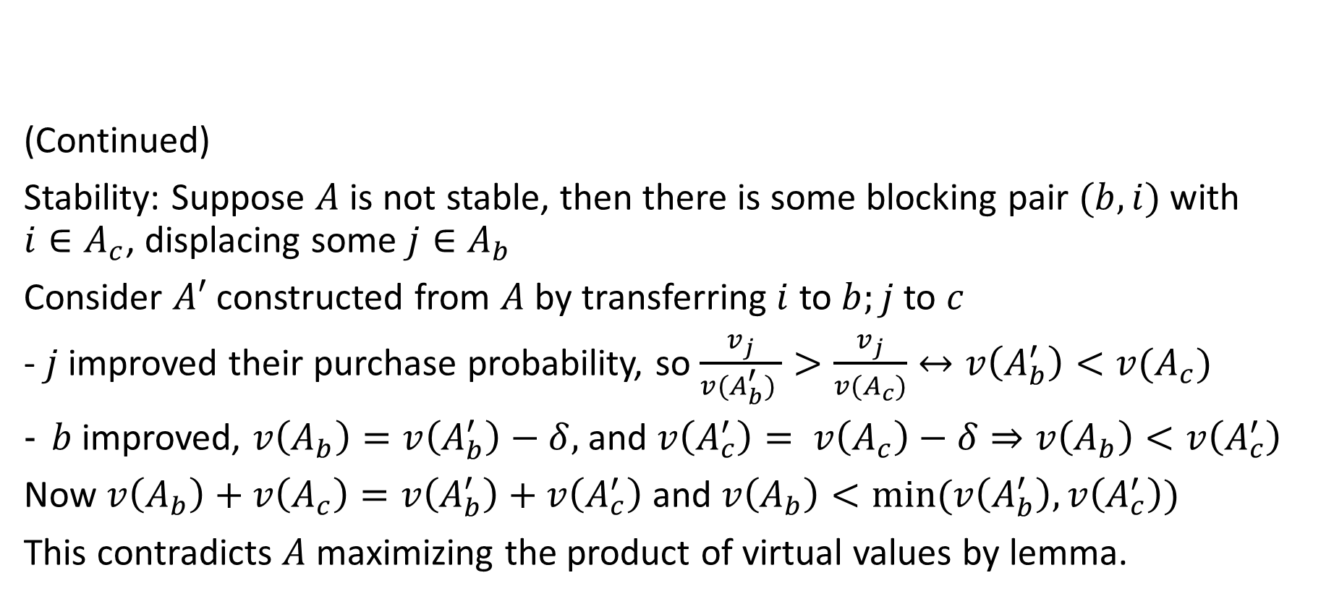
Proof sketch for identical values
(Continued)
Stability: Suppose $A$ is not stable, then there is some blocking pair $(b,i)$ with $i∈A_{c}$, displacing some $j∈A_{b}$
Consider $A′$ constructed from $A$ by transferring $i$ to $b;j$ to $c$
- $j$ improved their purchase probability, so $\frac{v_{j}}{v(A_{b}^{′}) }>\frac{v_{j}}{v(A_{c})}↔v\left(A_{b}^{′}\right)<v(A_{c})$
$b$ improved, $v\left(A_{b}\right)=v\left(A_{b}^{′}\right)−δ,$ and $v\left(A_{c}^{′}\right)= v\left(A_{c}\right)−δ⇒v\left(A_{b}\right)<v\left(A_{c}^{′}\right)$
Now $v\left(A_{b}\right)+v\left(A_{c}\right)=v\left(A_{b}^{′}\right)+v\left(A_{c}^{′}\right)$ and $v\left(A_{b}\right)<min⁡(v\left(A_{b}^{′}\right),v\left(A_{c}^{′}\right))$
This contradicts $A$ maximizing the product of virtual values by lemma.
Thm. For identical buyers under unit exposure constraints, maximizing expected buyer welfare is stable, SEF1 and PO
Notes:
whatever

Slide 26
Generalizing to arbitrary capacities
Identical buyer values
Dichotomous values
General exposure constraints:
Thm. In these two settings under unit exposure constraints, maximizing expected buyer welfare is stable, SEF1 and PO
Thm. For identical buyers and general exposure constraints, maximizing expected buyer welfare is SEF1 and PO
Thm. For dichotomous buyers and general exposure constraints, maximizing expected buyer welfare is stable and PO
Notes:
Put examples in the back of what you lose
Identical – unit capacities – very competitive choice sets. Lesss competitive for general constraints
For example, 2 agents, 1 compy of best item, 2 copies of 2nd best. Someone must get best + 2nd best, much more competitive choice set – instability
Dichotomous – constraints can force 2 agents to receive a bundle of common goods, that one values much higher than the other.
2 other groups of items that the agree on, good items and bad ones. Max product means the person with lower value for common goods gets good ones, other gets bad ones,
Can create large envy

Slide 27
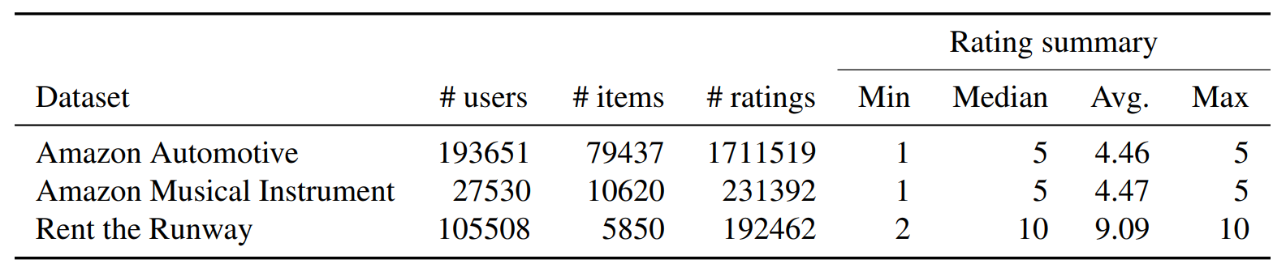
Stability in practical settings
Data from two real-world settings with capacity constraints:
Rent-the-runway: clothing rental
Two Amazon categories: musical instruments, automotive
Experiment: Estimate values with standard collaborative filtering alg (SVD++), sample users and items, produce 5-recommendation, evaluate.
Notes:
Easure instability in real data – is there really a risk of the market unravelling?
RtR – in the process of becoming a platform – allowing others to manage inventory and making recommendations

Slide 28
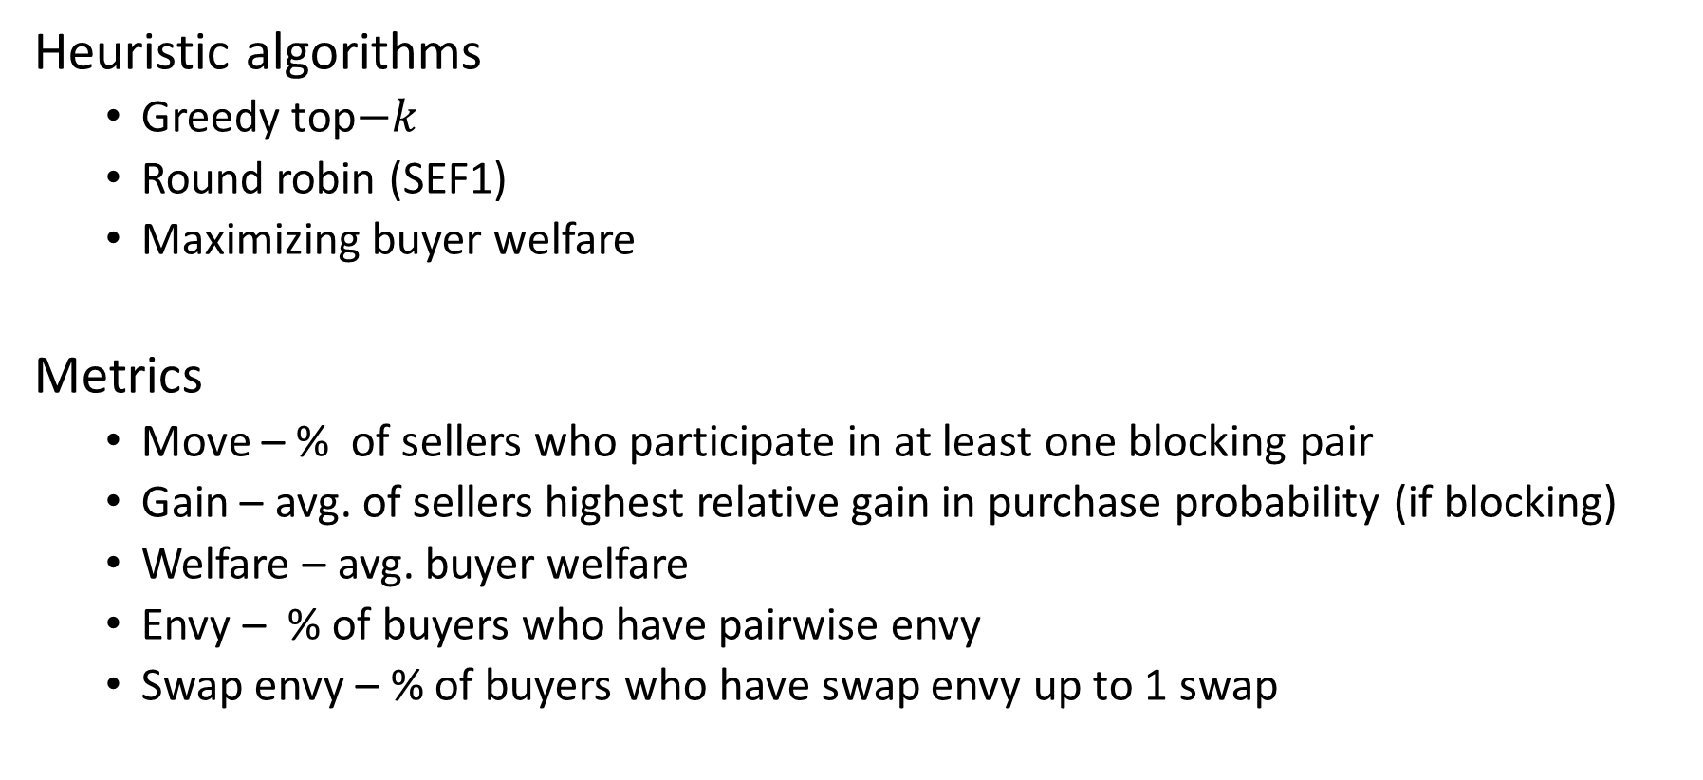
Algorithms and metrics
Heuristic algorithms
Greedy top$−k$
Round robin (SEF1)
Maximizing buyer welfare
Metrics
Move – % of sellers who participate in at least one blocking pair
Gain – avg. of sellers highest relative gain in purchase probability (if blocking)
Welfare – avg. buyer welfare
Envy – % of buyers who have pairwise envy
Swap envy – % of buyers who have swap envy up to 1 swap
Notes:
All algs satisfy respect cexposure constraints
Greedy – closest to the online version of the problem
RR – always SEF1 - straightforward
Max welfare – no guarantee to have any nice properties here, not even to find stable match on instances where it exists.

Slide 29
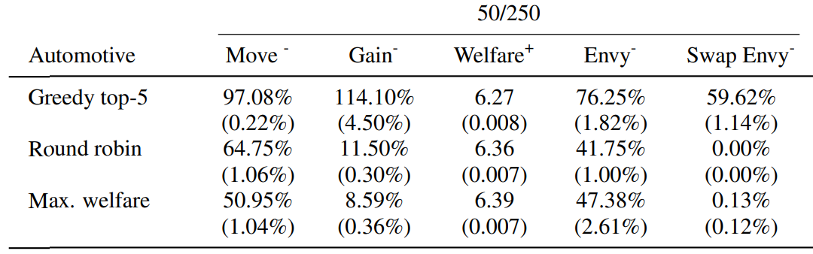
Notes:
Move – all have > 50% participating in BP
Gain – much less incentive to deviate for round robin and Max welfare
Welfare – of course higher, not by much
Envy – significant fraction of buyers have envy for all algs, but can eliminate single swaps for RR/MW
0 given by theory for RR

Slide 30
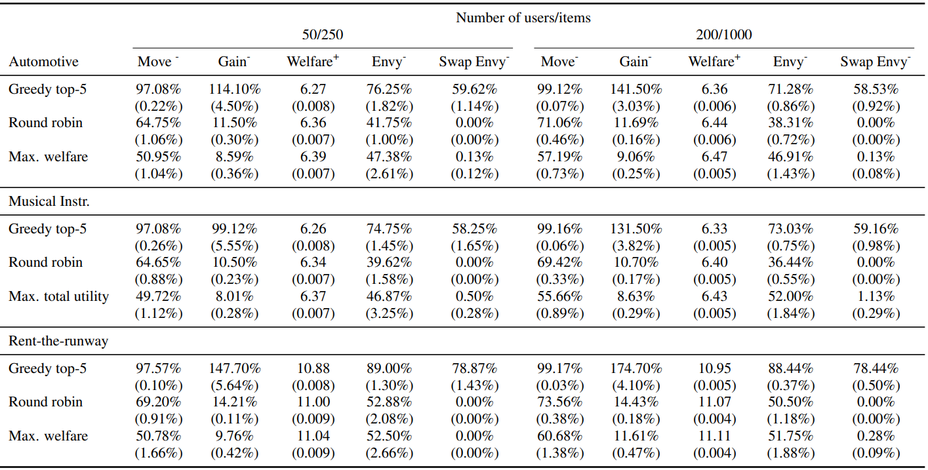
Notes:
Robust when changing data set and instance size
Greedy top-k clearly worst, but also the alg that comes closest to the online version of the problem
Open problem – are there online recommendation strategies that are stable/have low incentive to deviate and little to no swapa envy online?

Slide 31
Conclusion and open problems
Maximizing buyer welfare is guaranteed to be stable in special settings and appears to be a good heuristic in general
Is there a clean characterization of when stability can be guaranteed?
Are there efficient algorithms to find stable recommendations when they exist?
Is stability the right notion of 2-sided fairness to use here?

Slide 32
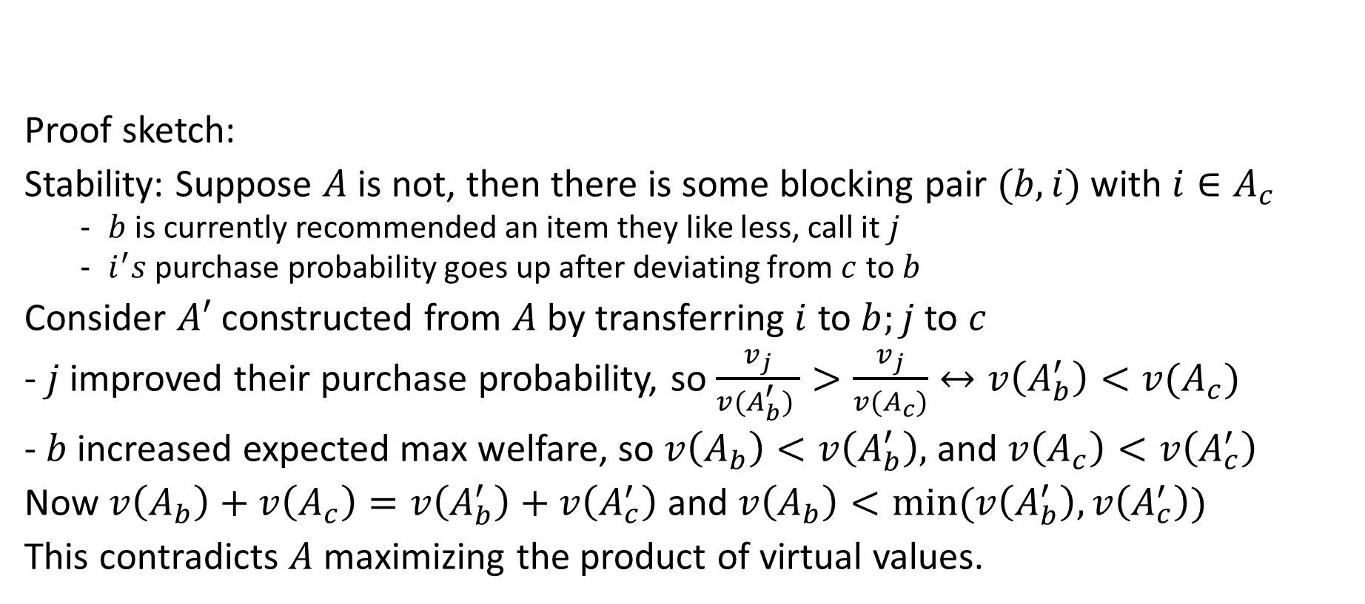
Proof sketch for identical values
Proof sketch:
Stability: Suppose $A$ is not, then there is some blocking pair $(b,i)$ with $i∈A_{c}$
$b$ is currently recommended an item they like less, call it $j$
$i^{′}s$ purchase probability goes up after deviating from $c$ to $b$
Consider $A′$ constructed from $A$ by transferring $i$ to $b;j$ to $c$
- $j$ improved their purchase probability, so $\frac{v_{j}}{v(A_{b}^{′}) }>\frac{v_{j}}{v(A_{c})}↔v\left(A_{b}^{′}\right)<v(A_{c})$
- $b$ increased expected max welfare, so $v\left(A_{b}\right)<v\left(A_{b}^{′}\right),$ and $v\left(A_{c}\right)<v\left(A_{c}^{′}\right)$
Now $v\left(A_{b}\right)+v\left(A_{c}\right)=v\left(A_{b}^{′}\right)+v\left(A_{c}^{′}\right)$ and $v\left(A_{b}\right)<min⁡(v\left(A_{b}^{′}\right),v\left(A_{c}^{′}\right))$
This contradicts $A$ maximizing the product of virtual values.
Thm. For identical buyers under unit exposure constraints, maximizing expected buyer welfare is stable, SEF1 and PO

Slide 33
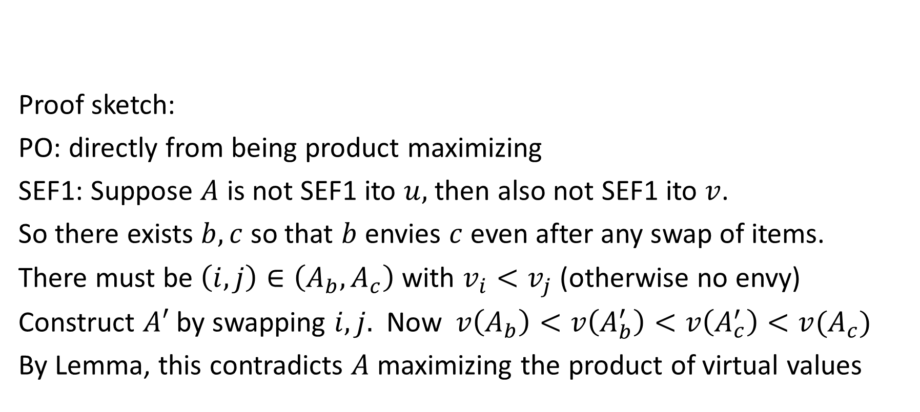
Proof sketch for identical values
Proof sketch:
PO: directly from being product maximizing
SEF1: Suppose $A$ is not SEF1 ito $u,$ then also not SEF1 ito $v$.
So there exists $b,c$ so that $b$ envies $c$ even after any swap of items.
There must be $\left(i,j\right)∈\left(A_{b},A_{c}\right)$ with $v_{i}<v_{j}$ (otherwise no envy)
Construct $A′$ by swapping $i,j.$ Now$v\left(A_{b}\right)<v\left(A_{b}^{′}\right)<v\left(A_{c}^{′}\right)<v(A_{c})$
By Lemma, this contradicts $A$ maximizing the product of virtual values
Thm. For identical buyers under unit exposure constraints, maximizing expected buyer welfare is stable, SEF1 and PO
Notes:
2nd transition by assumption that it is not sef1

Slide 34
Recommender systems
Recommend subset of items to users, given varying degrees of information about user and item attributes
Netflix/Yelp/DonorsChoose
Explore/exploit
Example, top-k recommendations
Capacities
Multiparty fairness

Slide 35
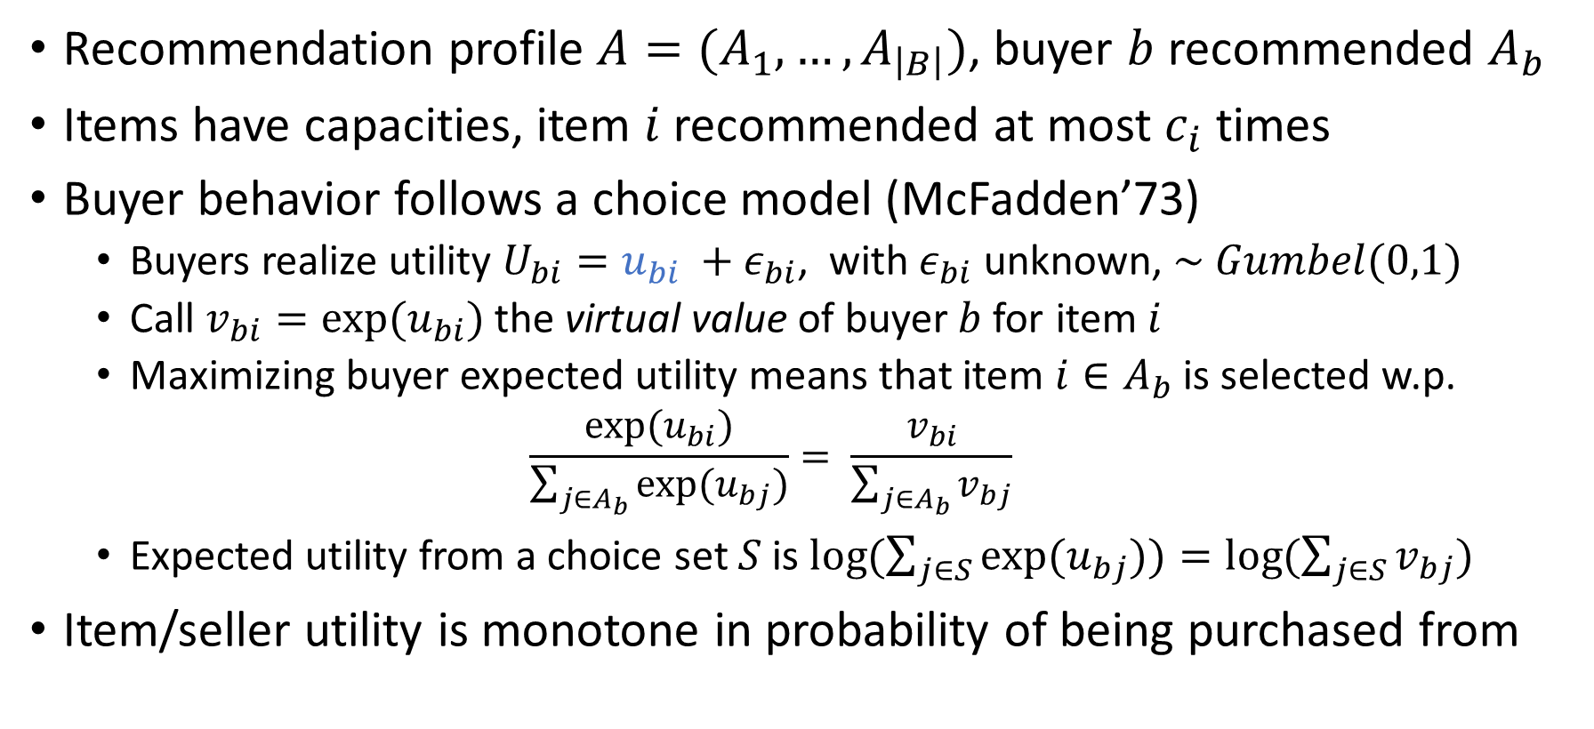
Model setup
Recommendation profile $A=(A_{1},…, A_{\left|B\right|})$, buyer $b$ recommended $A_{b}$
Items have capacities, item $i$recommended at most $c_{i}$ times
Buyer behavior follows a choice model (McFadden’73)
Buyers realize utility $U_{bi}=u_{bi} +ε_{bi}$, with $ε_{bi}$ unknown, $\sim Gumbel(0,1)$
Call $v_{bi}=exp⁡(u_{bi})$ the virtual value of buyer$b$for item $i$
Maximizing buyer expected utility means that item $i∈A_{b}$ is selected w.p.
$$\frac{\exp{{(u}_{bi})}}{\sum_{j∈A_{b}}{\exp{(u_{bj})}}}= \frac{v_{bi}}{\sum_{j∈A_{b}}{v_{bj}}}$$
Expected utility from a choice set $S$is $\log{(\sum_{j∈S}{\exp{(u_{bj})})=log⁡(\sum_{j∈S}{v_{bj})} }}$
Item/seller utility is monotone in probability of being purchased from
Notes:
Gumbel mean 0 beta 1 = extreme value type 1
Models distribution of maxima of multiple samples from a distribution.
F(x) = exp(-exp(-s))

Slide 37



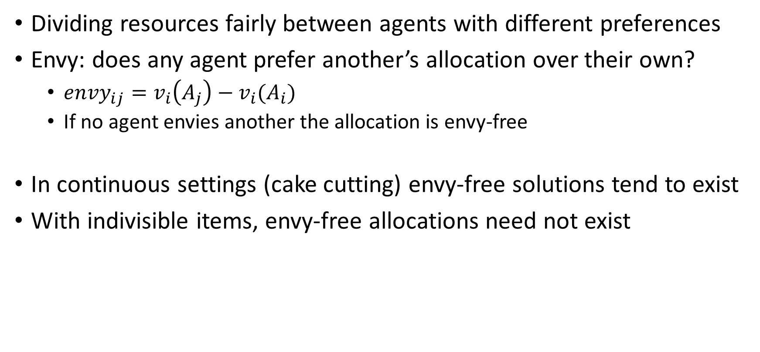
Fair division
Dividing resources fairly between agents with different preferences
Envy: does any agent prefer another’s allocation over their own?
$envy_{ij}=v_{i}\left(A_{j}\right)−v_{i}(A_{i})$
If no agent envies another the allocation is envy-free
In continuous settings (cake cutting) envy-free solutions tend to exist
With indivisible items, envy-free allocations need not exist
Notes:
Classical example non-homogeneous cake
envy: satisfied

Slide 38




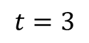
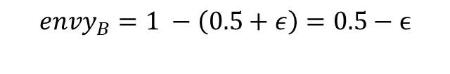
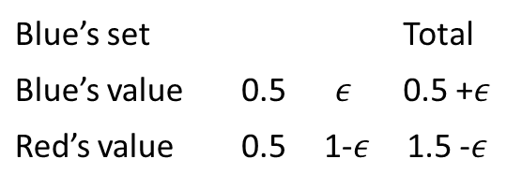
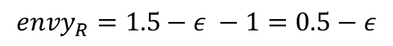
Online fair division with partial information
Agents are static, items arrive online [BKPP’18]
Don’t observe values, but the rank compared to subset of prior items
$$t=3$$
L
$$envy_{R}=1.5−ε −1=0.5−ε$$
Red’s set |  |  | Total
Red’s value |  | 1 | 1
Blue’s value |  | 1 | 1
1
1
Both agents have envy, even though every item was given to an agent who ranked it highest
Blue’s set |  |  | Total
Blue’s value | 0.5 | $$ε$$ | 0.5 +$ε$
Red’s value | 0.5 | 1-$ε$ | 1.5 -$ε$
L
1
1
$$envy_{B}=1 −\left(0.5+ε\right)=0.5−ϵ$$
2
2
Notes:
Mistake: the pie. If we had values we may have done better, but we only had rankings and gave to highest rank

Slide 39
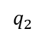
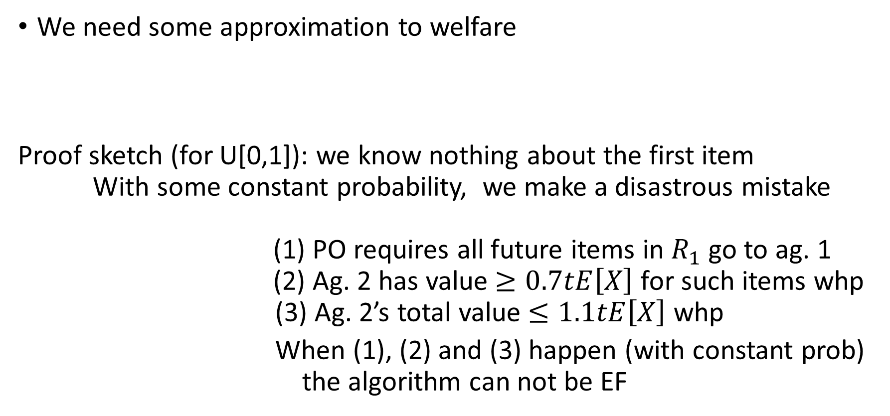
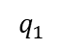
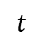
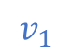
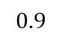
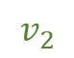
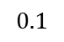
Unbounded memory
We need some approximation to welfare
Proof sketch (for U[0,1]): we know nothing about the first item
With some constant probability, we make a disastrous mistake
(1) PO requires all future items in $R_{1}$ go to ag. 1
(2) Ag. 2 has value $≥0.7tE\left[X\right]$ for such items whp
(3) Ag. 2’s total value $≤1.1tE\left[X\right]$ whp
When (1), (2) and (3) happen (with constant prob) the algorithm can not be EF
Thm. In the iid model for 2 agents, no algorithm is one-swap PO and EF w.h.p., even for values sampled from a known continuous and bounded distrib..
$$q_{2}$$
1
$$0.9$$
$$t$$
$$v_{2}$$
$$q_{1}$$
$$v_{1}$$
$$0.1$$
Notes:
Assume we give it to

Slide 40
Thinking about memory
Thm. In the iid model with unbounded memory, Alg 1 is EF and $\left(1−ε\right)$-WO whp
As sampling phases get longer, we ask for a rank relative to many items
Can we do better? What if we ask for comparison to only 1 prior item?
Model
1 benchmark item per agent, report H/L for each new item
When allocating an item, you may store it and release the previous
Once an item is allocated and not stored or stored and subsequently released, it can not be made benchmark again
Notes:
Rank relative to many items – binary search, T-> infty, annoying.
start by assuming you cant give a true value, then it is a little weird to as for a position in a ranking (quantile)

Slide 41




Recommender systems
Recommend subset of items to users, given varying degrees of information about user and item attributes
86
74
Top-k
78
Diversity

